Slide 1
Instrumentum Laboris Part 2
Five Franciscan Martyrs Region Annual Meeting

Slide 2
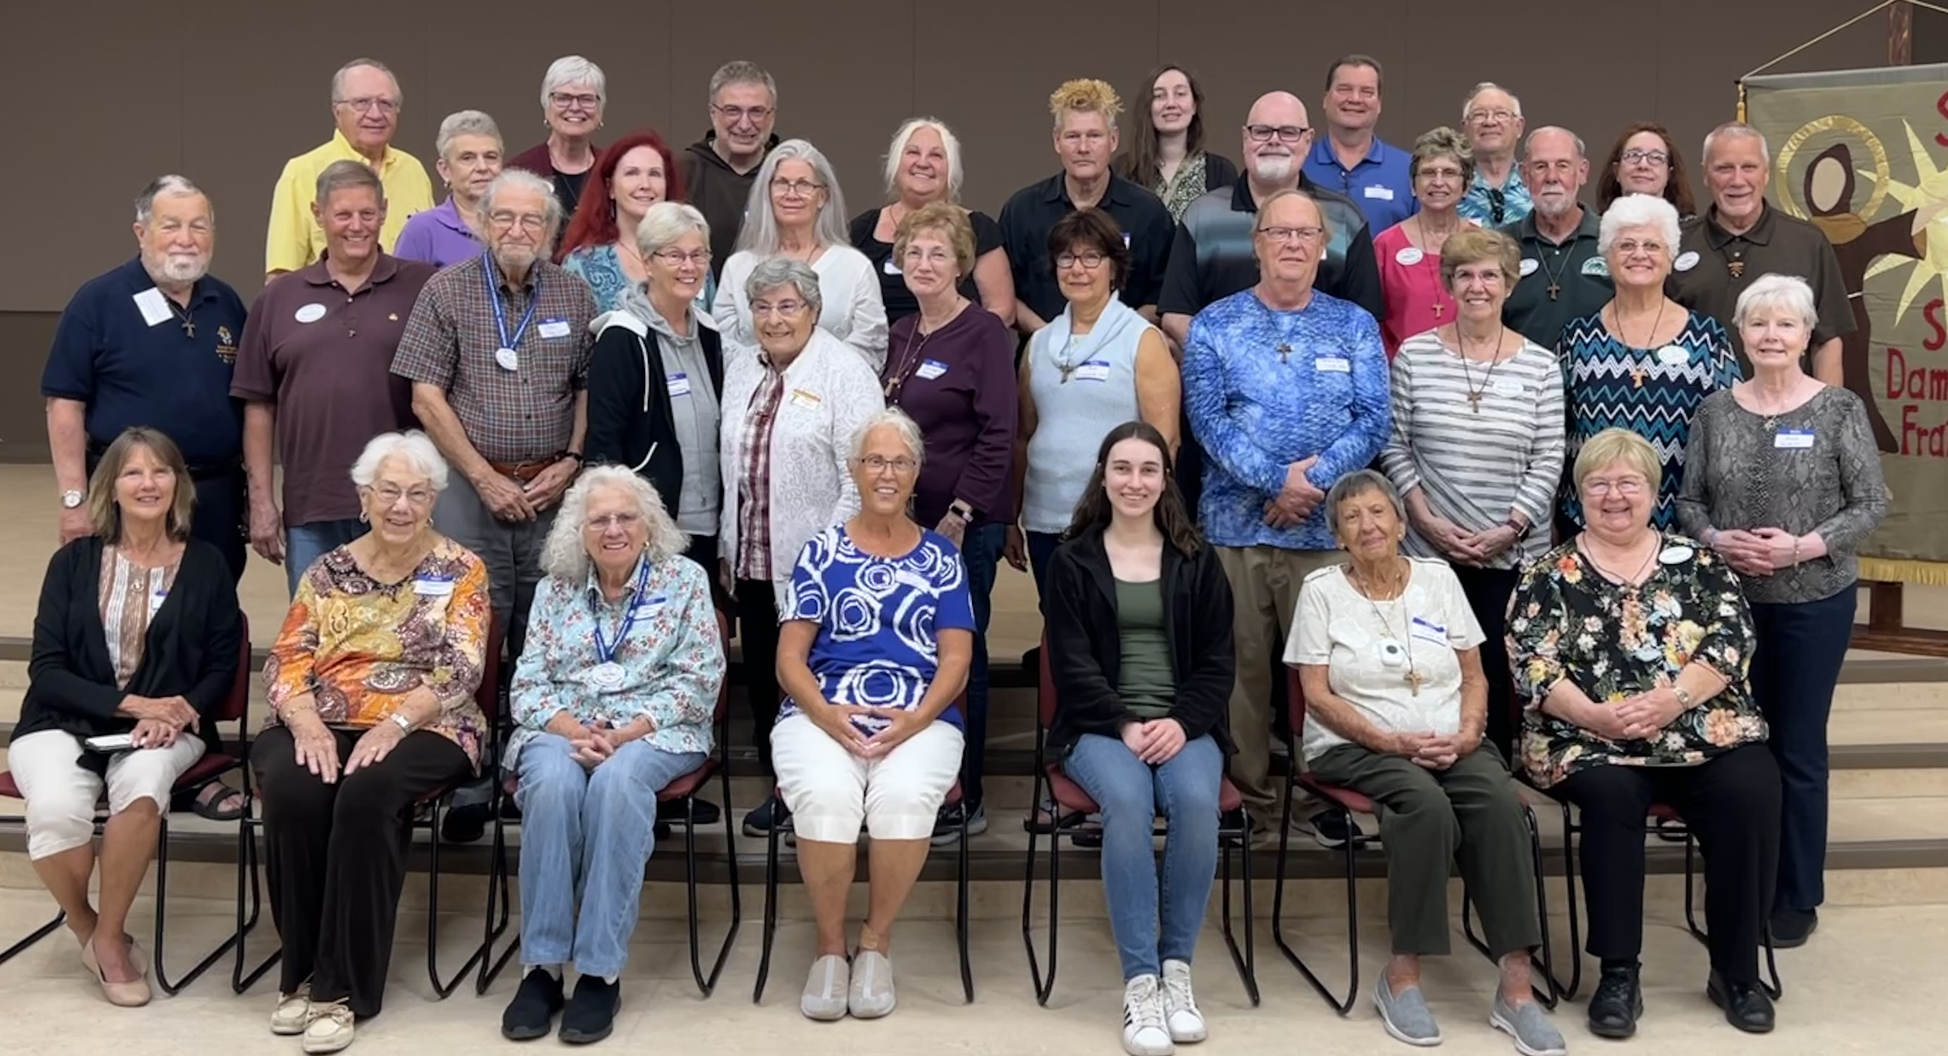
Some of the 50 attendees at our 10th Annual Day of Reflection
San Damiano Fraternity – Ruskin, FL
Annual Retreat for Neighboring Fraternities

Slide 3
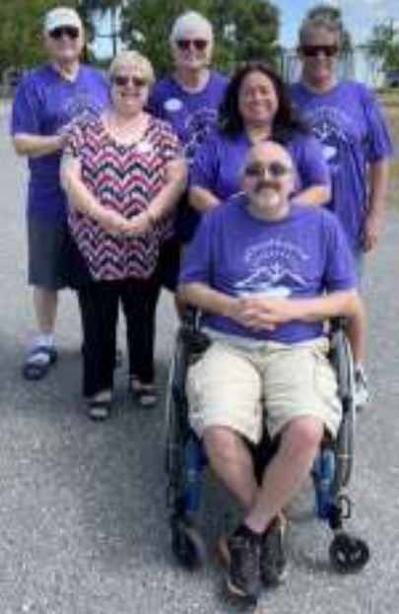
San Damiano Fraternity. Ruskin FL.
Kristine Littrell, OfS Minister. The Instrumentum
Laboris Team is a shared Responsibility of the Council
Area(s) being worked on: Demographics, Finances, Youth/Young Adult,
Servant Leadership, Ministries & Apostolates, Formation.
What action(s) are you working on at this time?
• We are hoping to initiate a workshop for our Formation Team to be given by our Spiritual Assistant, Friar Henry Fulmer, OFM – a training workshop especially for formators. (Formation)
• Invite St. Michael the Archangel and other fraternities in our Family, especially those who are involved in directing formation activities. (Formation)

Slide 4
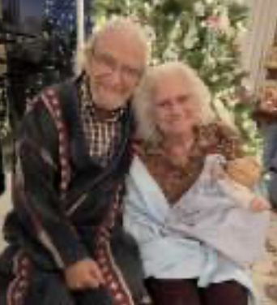
What action(s) have you completed by today?
• Hosted our 10th Annual Day of Reflection at Dayspring Retreat Center in Parrish, FL, attended by members of several fraternities in our Family, and led by Father Nicholas Mormando, OFM Cap
• Joined St. Michael the Archangel Fraternity in Tampa for a workshop on Servant Leadership given by our shared Spiritual Assistant, Friar Henry Fulmer, OFM. (Servant Leadership)
• Sent letter to our host parish pastor with an annual report of our activities including pictures and copies of our Brochure. (Demographics)
• Submitted notices and pictures to the parish bulletin, inviting interested people
to come check us out. (Demographics)
• Participated as a group in a parish fundraiser and annual picnic. (Visibility)
• Individual members participate in parish service, i.e., Altar Servers, Eucharistic
Ministers, Bereavement Group Leader, Food Pantry, etc. (Visibility)
• Two of our fraternity council members were featured in a feature article with
cover photo in a publication, Parish Neighbors, that is distributed to several
parishes in our area. The focus of the article was on their lives as Secular Franciscans. (Visibility)
• We have established a monthly giving program for all fraternity members that meets our goal of making our annual Fair Share payment and allows us to plan and support several fraternity apostolates. (Finance & Apostolates)
San Damiano Fraternity, Ruskin, Florida

Slide 5
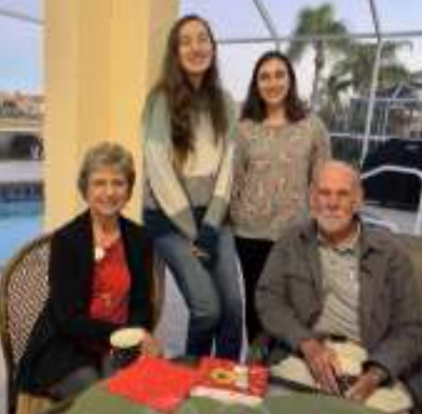
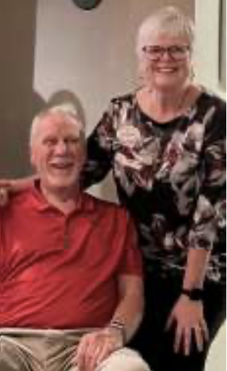
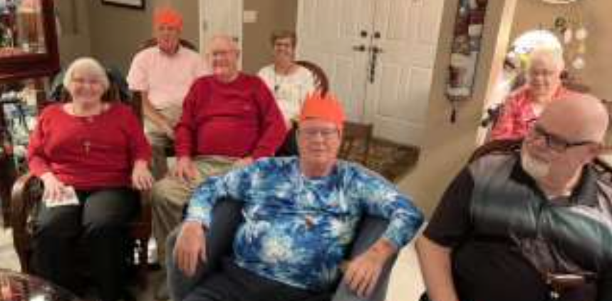
How can the Council assist you? By holding more in-person Family Meetings where we can share Fraternity with our greater Secular Franciscan Community, share ideas, and support one another.
San Damiano Fraternity, Ruskin, Florida

Slide 6
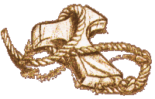
FFMR Council iL Committee for youth/young adult Youfra
What action(s) have you completed by today?
Zoom meetings were held for all new You/Fra Animators
Thumb drives with all essential YouFra documents have been compiled. They will be given out during lunch today to YouFra Animators.
Reworked materials concerning the mission of YouFra to make it FFMR specific in preparation for continued work within our Region
Pat Wolfert, OFS
Janice Mary Novello, OFS

Slide 7
Actions we are working on at this time
Planning future Zoom meetings both on line and in the field.
Reviewing materials and resources to share with YouFra Animators
Collecting data from YouFra Animators who have begun working in the field.
Distributing Flash Drives with essential information to each Animator
Be part of NAFRA Zoom meetings for news and updates in the new year.
Writing Workshop sessions with other NAFRA Commissioners
Uploading Webinars to website for animator review

Slide 8
Formation Toward the “Promise.”
June 20
Invitation
Formation Toward the “Promise.”
This Zoom webinar will be specifically for
Youth/Young Adult Animators
Ministers
Formators
Spiritual Assistants

Slide 9
Little Flock in Fairhope, Alabama
Little Flock members combined Youfra and JPIC as their goal
Three Peace Awards for Middle and High School
Students, Initiated the St. Francis Project at Little Flower Elementary School, Donations to the two Catholic High Schools in our area and offered books for children about St. Francis to the Catholic elementary schools.
Fraternity members attended the Mass at Prince of Peace parish and participated in the presentation of a Peace Award to a student member of the parish.
Catherine L. Vurraro, OFS Minister

Slide 10
Instrumentum Laboris Part 2
Five Franciscan Martyrs Region Annual Meeting

