Slide 1
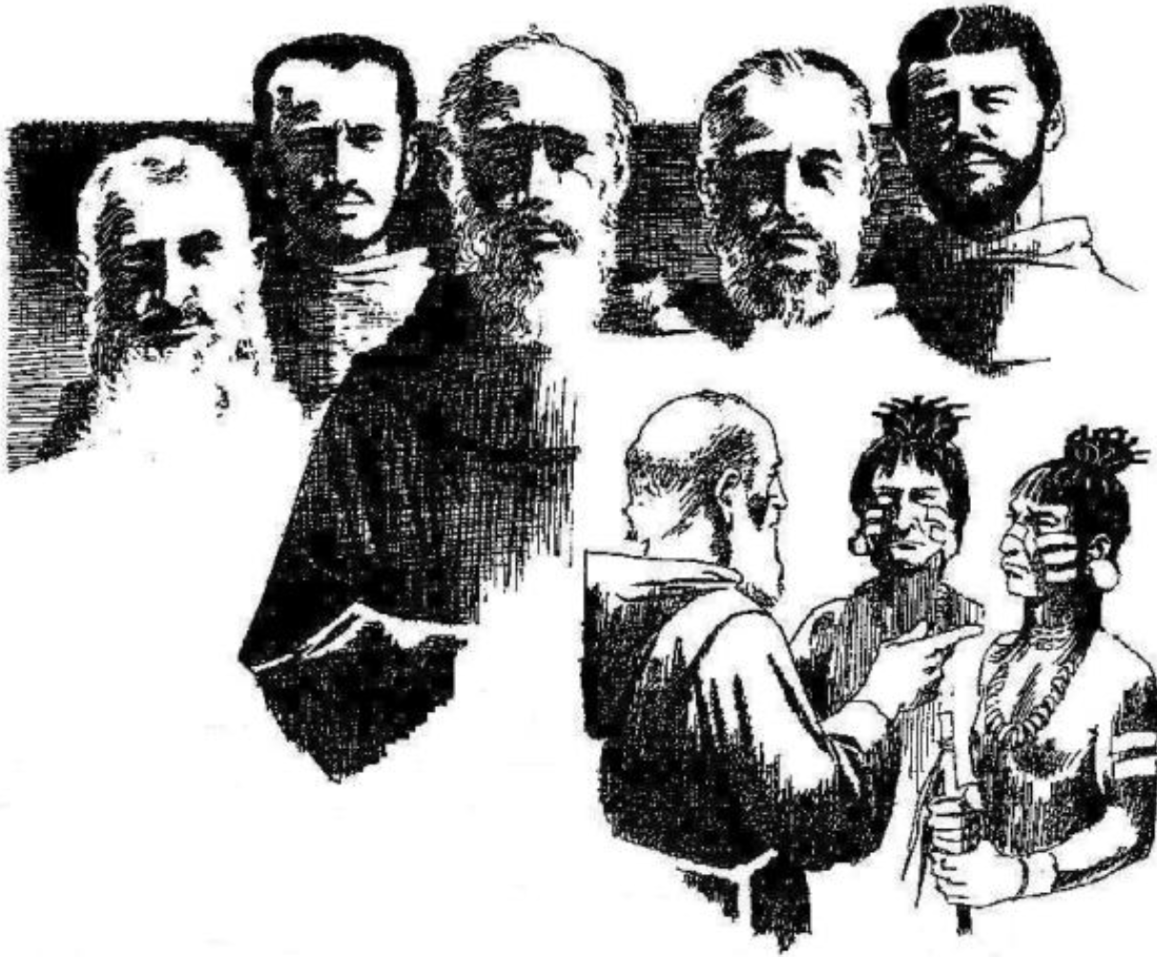
Instrumentum Laboris
Five Franciscan martyrs Region
Annual Meeting
June 2-4, 2023
San Pedro Retreat Center
Dr. J M Novello, OFS
Vice Minister

Slide 2
2022 Year Two

Slide 3
Rate of Response from Local Fraternities for our FFMR Annual Report to naFRA

Slide 4
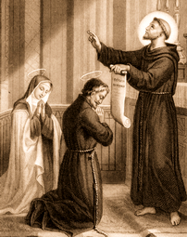
Instrumentum Laboris Worksheet
Instrumentum
Instrument
Laboris
Work
Blessed Luchesio and Buonadonna
April 28

Slide 5
St. Anthony Of Padua Fraternity Boynton Beach
Minister: Jane Rader, OFS
Goals:
Our actions were focused on training fraternity and council members to be able to take a place on the council.
We also updated our trifold brochure. With permission from their pastors, fraternity members from different parishes placed the brochures in their parish churches with other handouts.
We started an apostolate to seminarians for the local diocese and men in formation to become Conventual Franciscans by writing individual letters to them each month. We started in the spring and stopped over the summer because the seminarians went home or to other temporary assignments
The purpose is to familiarize the seminarians with who we are and, if they are secular, expose them to the Franciscan Order. Also, it will hopefully be a positive influence for potential future spiritual assistants.

Slide 6
St. Anthony Of Padua Fraternity Boynton Beach
Minister: Jane Rader, OFS
Goals:
Our actions were focused on training fraternity and council members to be able to take a place on the council.
We also updated our trifold brochure. With permission from their pastors, fraternity members from different parishes placed the brochures in their parish churches with other handouts.
We started an apostolate to seminarians for the local diocese and men in formation to become Conventual Franciscans by writing individual letters to them each month. We started in the spring and stopped over the summer because the seminarians went home or to other temporary assignments
The purpose is to familiarize the seminarians with who we are and, if they are secular, expose them to the Franciscan Order. Also, it will hopefully be a positive influence for potential future spiritual assistants.

Slide 7
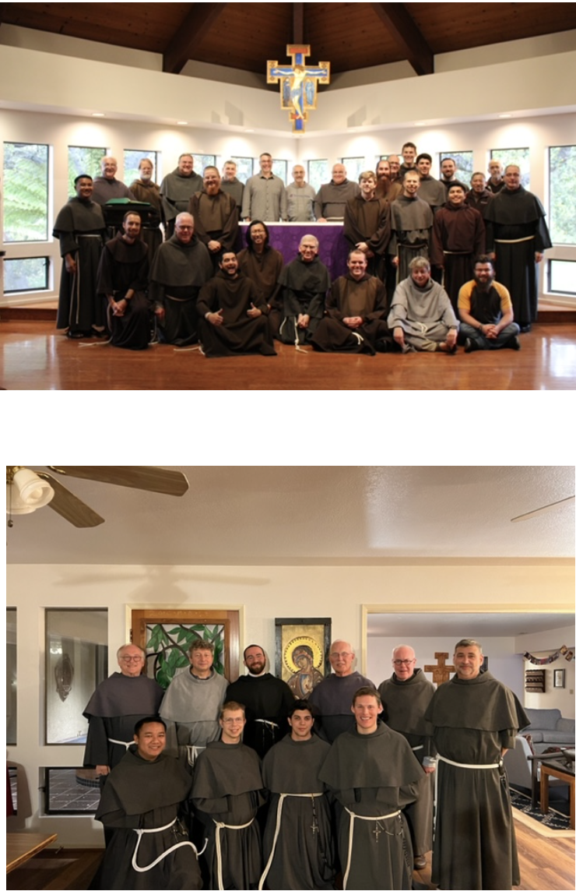
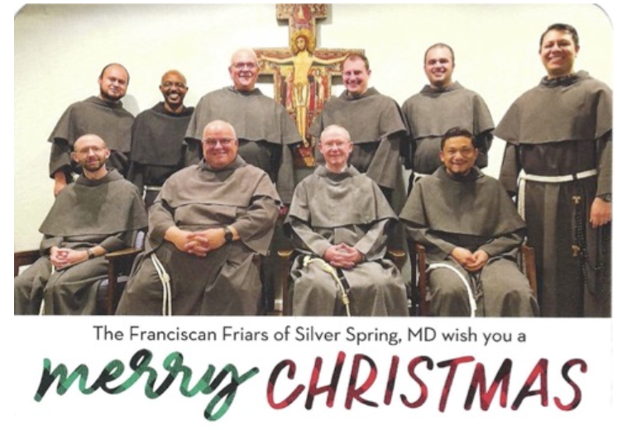
What action(s) have you completed by today?
We have written letters to the seminarians, participated in parish food drives for the needy, donated to Birthline/Lifeline, distributed fraternity brochures at the 2023 South Florida Fair, and we have been active on social media and published a new website.
Corresponding with the seminarians has been a wonderful experience for our members. The first photo (below) is a Christmas card that one of our members received from the Franciscan Friars of Silver Spring, MD. The second and third photos were sent to one of our members by Friar Marvin, one of the Conventual novices in Arroyo Grande, CA.
St. Anthony of Boynton Beach
Fraternity

Slide 8
Lady Poverty
Our Instrumentum Laboris Goal is to Increase efforts to bring new younger members into the Fraternity.
Michael Ruf, OFS. Minister
Sara Castro, OFS IL Animator

Slide 9
How have you completed your Goal for the beginning of your Project?
Lady Poverty Fraternity, Winter Park
Updated and printed new “Come and See” brochures and have them available at the San Facility with contact information and meeting information
Fraternity has become more active with the San Pedro Center
Senior Days at San Pedro has changed its name to San Damiano Society

Slide 10
Mother of the Living Gospel
We focused on four areas: Vocations,
Formation,
Apostolates,
Youth.
This information is based on input from our entire membership. We focused on seven questions per area. The questions and goals are acollaborative effort to respond to Instrumentum Laboris
Minister: Margie C. Sweeney, OFS

Slide 11
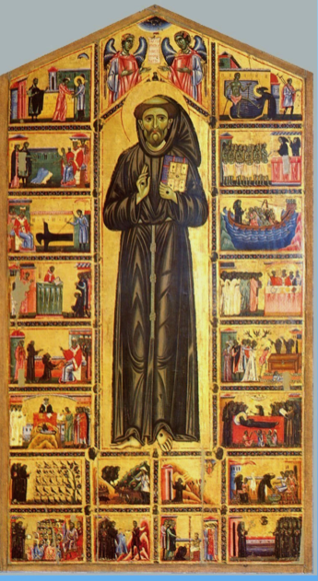
Planned steps to be completed in the first 12 months
Proper formation of conscience.
Social media to evangelize.
Bulletin announcement to bring awareness to our presence.
Witness to our Franciscan charism.
Wearing our Tau Cross.
Wearing Franciscan T-shirts at events or otherwise.

Slide 13
St Joseph Fraternity
Jesse Chiccone, OFS Minister
Kathleen Minnet, OFS Secretary, Instrumentum Laboris Team Leader
1. Holy prayer; 2. acts of true charity and to 3. rightly teach Fraternity members about authentic Catholic teaching regarding our true Franciscan identity, including participation in OFS Franciscan Servant Leadership acts.
All OFS are called to Franciscan Servant Leadership but in different ways, according to the mysterious call and will of God; dependent upon the grace of God and our ability to cooperate with His grace, to do God’s will not our own will.
The Three holy actions that the Fraternity has agreed to work on regarding “Servant Leadership” are

Slide 14
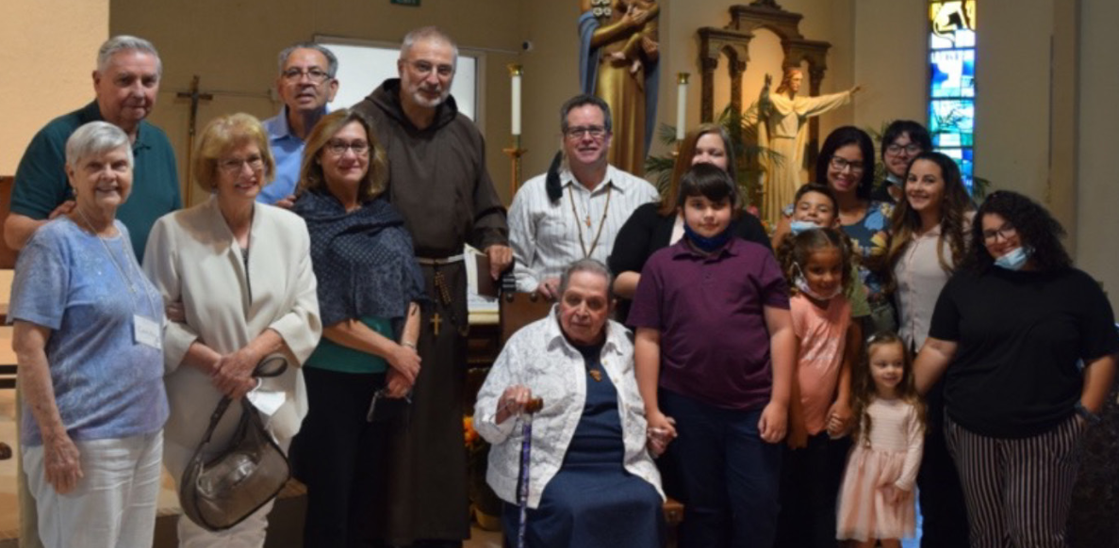
Goal of 3 holy actions: To bring forth holy humble faithful loving OFS Servant Leaders who participate in bringing forth, more fully, the mysteries of the divine will of love and help participate with God in creating His Saints.
St. Joseph Fraternity

Slide 15
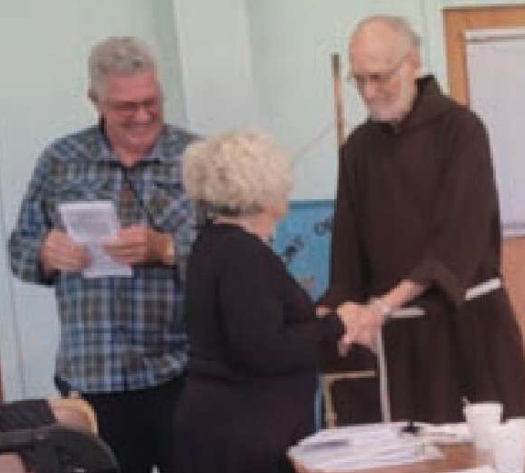
What step(s) have been completed in 1 year?
St. Joseph Fraternity
Continue prayer for God’s Servant Leaders to be formed in holiness and brought forth,
Continue acts of charity and teaching of authentic charism of Franciscan Servant Leadership knowledge and skills, as described above, but all this only possible with God’s grace and will in unity with soul of the Fraternity
Add Franciscan Servant Leadership Experiential training to those members who feel that God may be calling them to serve as leaders on the Council or OFS in some capacity

Slide 16
St. Clare Fraternity Ave Maria
Goal by 2035: To have an established Youth/Young Adult Group
Met with Fr. Martignetti, OFS, the Spiritual Assistant for the students at Ave Maria University.
Celebrated the Feast of Saint Clare with the students
Participated in Vocations Day at the University
Fraternity members are working to connect with the youth ministers in their individual parishes to share discussions about Saint Francis and his followers.

Slide 17
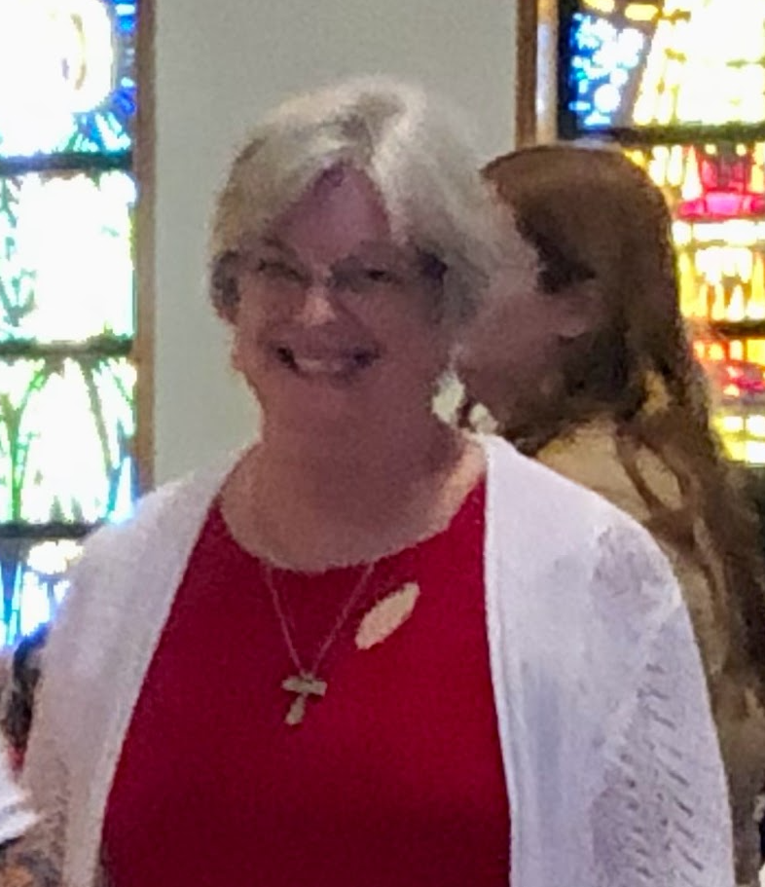
St. Clare Fraternity Ave Maria
Goal by 2035: To have an established Youth/Young Adult Group
The fraternity is working to find the time to meet with parish youth ministers to schedule talks with the students.
How can the Council Assist You?
Response: Sample presentation for young adults about Saint Francis
Sheila Solomon, OFS. Minister

Slide 18
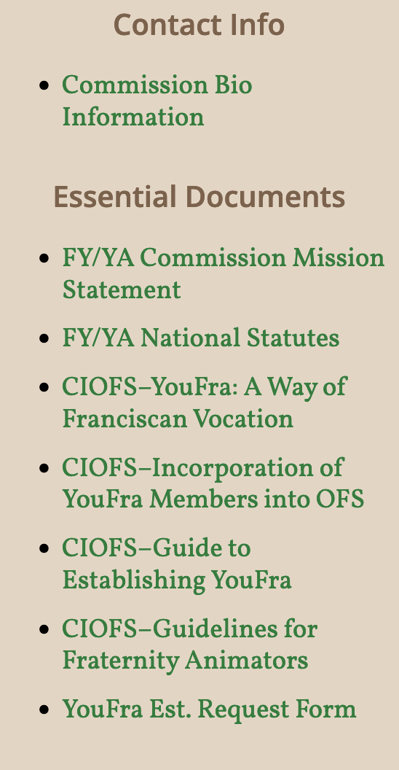
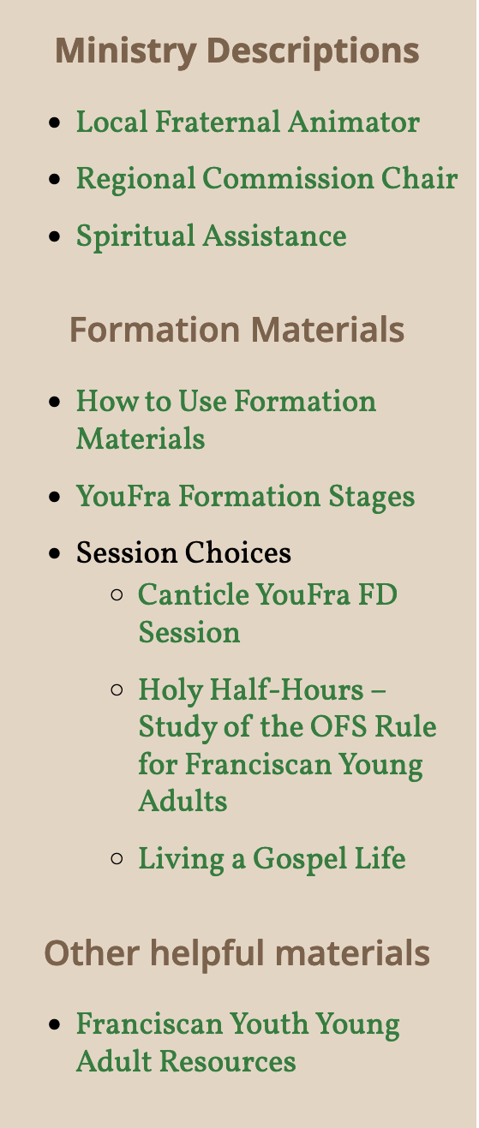
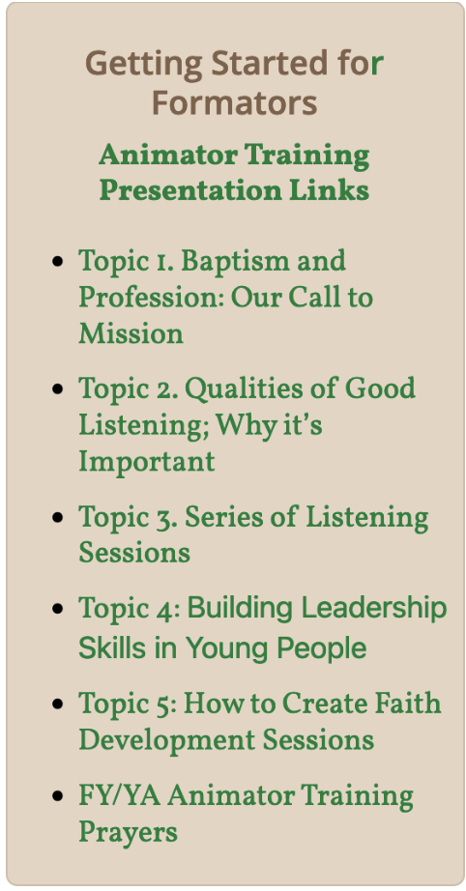
Animator for the Fraternity can become the Formator for the Youth/Young Adult Youfra group

Slide 19
Instrumentum Laboris
1 Corinthians 12
⁴ There are different kinds of gifts, but the same Spirit distributes them. ⁵ There are different kinds of service, but the same Lord. ⁶ There are different kinds of working, but in all of them and in everyone it is the same God at work.
⁷ Now to each one the manifestation of the Spirit is given for the common good. ⁸ To one there is given through the Spirit a message of wisdom, to another a message of knowledge by means of the same Spirit, ⁹ to another faith by the same Spirit, to another gifts of healing by that one Spirit, ¹⁰ to another miraculous powers, to another prophecy, to another distinguishing between spirits, to another speaking in different kinds of tongues, and to still another the interpretation of tongues. ¹¹ All these are the work of one and the same Spirit, and he distributes them to each one, just as he determines.

